Slide 1
Biomedical Engineering
Angelica Rodriguez, Ben Paul, Corey Alexander, Lindsey Watterson

Slide 2

Quality Factors
High level of correctness
Efficiency
Security
Reliable
High Usability

Slide 3

FDA Biomedical Software Regulations/Standards
Accuracy, Reliability, ability to discern invalid or altered records
Generate accurate and complete copies of records for reading and electronic inspection, review, and copying
Protection of records
Limit system access
Accurately track all record creations, modifications, and deletions
System checks to ensure correct sequencing of steps and events
More at http://www.accessdata.fda.gov/scripts/cdrh/cfdocs/cfcfr/CFRSearch.cfm?CFRPart=11&showFR=1&subpartNode=21:1.0.1.1.7.2
All other testing is up to the developer

Slide 4
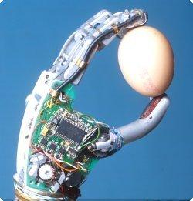
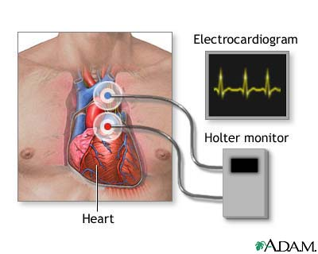
Specific Examples Of Certain Criteria
Surgical Machines
Accuracy: 1mm difference can make the difference between saving a life or losing it
Prosthetics and implant devices
Reliability: needs to do the same time every time
Security
Hackers can gain access to patient heart monitors

Slide 5
Metrics
Chosen by individual developers and companies and are not regulated
Commonly used:
McCabe Cyclomatic Complexity
Lines of Code written
Suggested:
Average Number of Comment Lines per Method
Average Method Size

Slide 6

Common Problems
Inability to test the software under real world conditions
Rarely have patients willing to have surgeries or implants to test software
Can only extensively test in labs

Slide 7

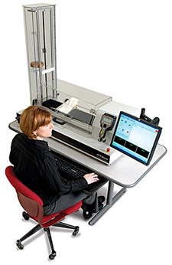
Suggested Testing
Database
UX and usability test for frontends
Stress testing
Software for equipment and devices
Robust Worst Case Testing

Slide 8
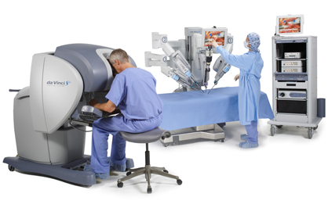
Successes and Failures
Implants and Surgical Equipment
Robotic equipment allows doctor to perform a surgery
Implanted insulin pump fails to recognize the amount of insulin in the body
Heart rate monitor fails and gives incorrect results such as flat-lining
Database and Hospital Systems
Stores and returns data correctly within a specified speed range
Fails if breaks those conditions

